Slide 1

Scaling up
SSE USTC Qing Ding
dingqing@ustc.edu.cn

Slide 2

Scaling up
If your company is successful, your web presence is going to have to grow.
Some suggestions of things that you might need to consider

Slide 3
Generic advice
(applicable anywhere, not just your web site)

Slide 4
Generic advice
Don’t overengineer
Design to scale
Simplify
When extending or updating – plan for rollbacks
Use testing software
Use your logs

Slide 5
Don’t overengineer
Don’t overengineer
  2nd system‐itis;
  Built to amaze your geeky friends;
  Exploits every design pattern in the book;
  Uses all known extensions of servlets;
  Native mode apps for all platforms for an application that displays static data read from a data store; …
  Er – best not.

Slide 6
Design to scale
Design to scale
  Estimate the size of the workload on the system you are to build
    Design a system that could conceivably handle up to 20 times that workload
    Implement a version of that design that could handle up to 3 times the expected workload
    Deploy a system that can handle 1.5 times the expected workload

Slide 7
Simplify
Simplify
  Simplify scope
    Pareto principle usually applies – 80% of benefit from 20% of features; identify the 20% that matter and limit the scope
  Simplify design
  Simplify Implementation
    Exploit standard solutions –
      Class libraries,
      Automatic code generation,
      Automated ORM,
      Web frameworks (MVC, component, CMS, …),
      Application engines
      Open source
      Use services
        Don’t try to handle payments for your little web company, subcontract to PayPal

Slide 8
When extending or updating …
Plan upgrades of your system to allow for rollback
  Your new release software should (!) have been tested in a staging environment, but nothing really compares with the full load of a production environment
    It seemed great, but when deployed the web site load exploded
  If production deployment bombs, you need to be able to go back to a previously working version
  ….

Slide 9
Planning for rollbacks
Changes to the database
  Don’t remove columns from tables, somewhere there is bound to be some code that still uses the column that you decided to delete!
  Use SQL scripts to make changes to tables – don’t try doing it by hand from the DB admin console
Selectively enabled change
  Try to make new features available subject to some environment variable setting in the application deployment file (application.ini, web.xml etc)
    Preferably a scheme so that a new feature can be enabled for a subset of users before it goes on general release
    “if request.inRole(‘adventurer’) && context.getParameter(‘trynewstuff’)!=null
    { … }”
…

Slide 10
Planning for rollbacks
Of course, your code is all version managed isn’t it.
  Don’t edit the working code, create new managed versions
  Remember those cacheable files out in proxies or browsers
  you got around them by using a reference to a new version in your pages
    Best have scripts that can run through all your files that can change references easily in any static pages; code creating dynamic pages should pick up filenames from environment data like application.ini

Slide 11
Use testing software to prepare a software release
Unit testing
Code coverage testing
Load testing
  Check out software that can simulate aspects of request traffic
    Apache JMeter
    Selenium WebDriver
    …
But of course you always use unit tests and code coverage don’t you.
Client server and web‐browser based applications require additional testing

Slide 12

Use your logs
Collect those access and error logs
  The logs may grow large, have a “chron job” that regularly grabs older logs from servers, archives them and merges them into a single log that gets analysed by your Perl scripts
    Delete old logs after archiving (or you will run out of disk)
Analyse the collected logs
  Check for behaviour typical of hacker probing attacks – be forewarned of impending attack
  Check for errors –
    errors logged by applications,
    errors relating to files not being found or inaccessible
  Check for things like aborted downloads
    Can act as signal that clients are finding your site to slow
  Maybe use for your own WebAnalytics
    Log based analytics are no longer fashionable but still sometimes used

Slide 13
Handling the workload
Server computers

Slide 14
Lots of cheap computers v. super‐fast top‐of‐the‐line model
It depends a bit on your company
  Well established company with stable IT infrastructure (think banks etc) may find it best to work with top‐end machines or mainframes and handle steady incremental growth by buying the biggest and best
  Most Web based companies are under capitalized, are (trying to) grow rapidly, and should adopt different strategies
    Increasing numbers of small commodity computers (blades etc) rather than a high‐end machine
Abbott and Fisher have an anecdote about an unnamed company (probably eBay) that in late 1990s was outgrowing its existing system based on six of the largest possible (IBM) mainframe servers; it switched to server farms with hundreds of little (Dell) machines.

Slide 15
Split the work
Back in 1990s, the way that you scaled up to handle a bigger workload was to buy a bigger computer
Now, you aim to use large numbers of commodity computers –
  blades, rack‐mount servers etc.
Need mechanisms that allow you to split the work across many machines
  Note splitting raises problems for stateful services

Slide 16
Ways to split
The simplest (your company just starting and you cannot afford specialized network architects and systems admins)
  Configure your DNS table so that you can have several machines associated with your “www.oursite.com” web address:
    Assume for simplicity that you have a “class C” domain with up to 254 computers in IP 206.205.204.*
  ; hosts
  localhost.oursite.com IN A 127.0.0.1
  www.oursite.com. IN A 206.205.204.1
  www.oursite.com. IN A 206.205.204.2
  www.oursite.com. IN A 206.205.204.3
        DNS server will use a “round‐robin” scheme that identifies different machines for lookup requests – gets load shared approximately equally among the computers

Slide 17
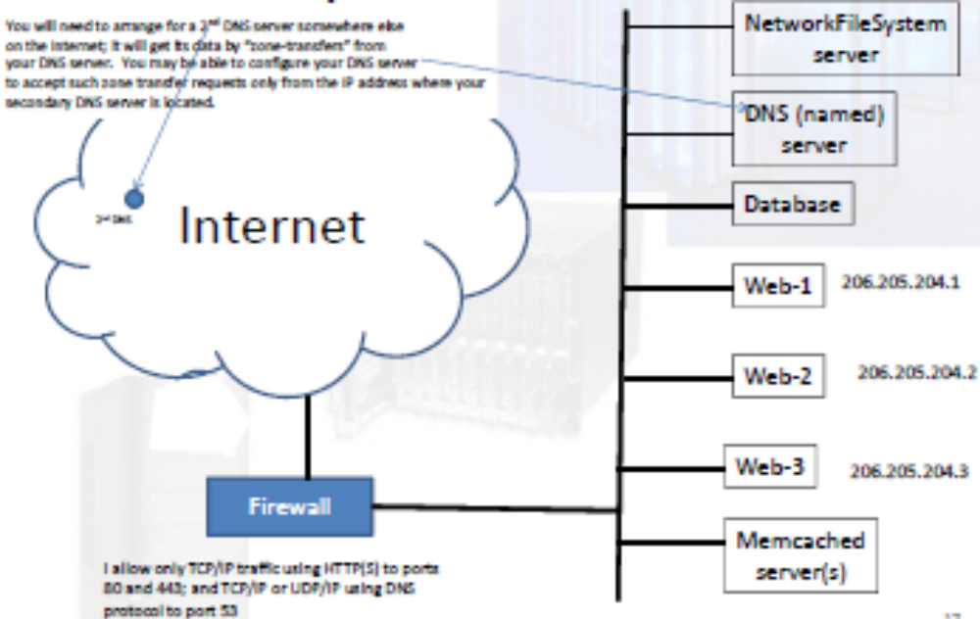
Simplest architecture

Slide 18
Simplest architecture
Web machines
  Lots of pre‐forked, single thread Apaches with PHP; nothing much else by way of software.
    Apache cache
      MMapFile for the static files that are always requested (duplicated in each)
Networked file‐server
  Holds all static files on some RAID array, also log files
DNS server
  Load from DNS wouldn’t be that high, this machine would do other work as well, e.g. acting as part of Memcached cluster
Memcached server(s)
  Cache data retrieved from database that can be assembled into response pages for many requests

Slide 19
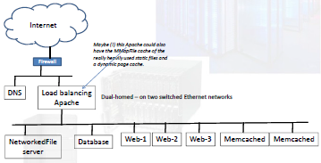
Growing larger

Slide 20
Apache load balancer
Some advantages over DNS round‐robin
  Algorithm for distributing load makes some allowance for current loads and response times
  It can help support “sticky sessions” (with subsequent requests always going to the same machine)
    Can use cookies from the application like J_SESSIONID (Java), PHPSESSION, or add its own cookies
  It can take on part of work needed for HTTPS
    It deals with establishment of the SSL connections
The suggested network partitioning (only DNS and load balancer Apache on a network directly accessible to others on the Internet) is hypothetical – but such things can be configured and do give additional security.

Slide 21
Apache load balancer
Configuration file for the load‐balancer Apache identifies the
server group:
# Set a cookie
Header add Set-Cookie "NODE=%{BALANCER_WORKER_ROUTE}e; path=/" \
env=BALANCER_ROUTE_CHANGED
# Create a load balancer named "web-nodes"
<Proxy balancer://web-nodes>
# Add three load balancer members
BalancerMember 192.168.0.1 route=1
BalancerMember 192.168.0.2 route=2
BalancerMember 192.168.0.3 route=3
# Use the NODE cookie for sticky sessions
ProxySet stickysession=NODE
</Proxy>
# Send all requests to the "web-nodes" balancer
ProxyPass / balancer://web-nodes
Well, bit more complex
if you are trying to cache on this machine as well

Slide 22
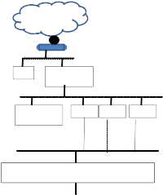
Growing larger and larger
Inter^{In}net
irewall
DNS
Load balancing Apache
Apaches with dynamic page caches
Networked Web‐1 Web‐2 Web‐3 File server
This would allow different protocols (not HTTP) e.g. the specialized protocol for Apache/Tomcat communications
Optionally a 2nd firewall
Database
AppServer
AppServer
AppServer
Memcached
Object cache – stuff fetched from database that may get used again₂₂

Slide 23
Larger and larger
Load balancer
  Maybe caches a few very frequently used static files
Web server level
  Return of simple files
  Forward requests for dynamic pages to appservers (Apache/Tomcat combination has lots of support)
    Apaches can be configured to work with clusters of Tomcats
  Cache complete dynamic pages
    Apache dynamic cache
Appserver level
  Talk to the database, generate responses
  Cache any reusable objects that represent data retrieved from database
  Cache complete pages –
    application can generate key when preparing SQL query and check whether the same query was run and the result page was generated and is still cached – in which case don’t do any work

Slide 24
The database
The heaviest cross you have to bear

Slide 25
Databases
The hardest problems when scaling up usually relate to the database
Splitting data sets to improve performance
Caching again
Transactions and locking
“Optimising” your SQL
Maybe you should not be using a database!

Slide 26
Databases
Usually, the hardest part of scaling up

Slide 27
Database
It’s easy to buy a few more computers on which to run the web‐servers (and application servers), but they all seem to need to work with the back end database.
  Database machine will be your highest rated computer, but it is still easy for it become overloaded and unresponsive
    And it’s a single point of failure that takes out your entire system

Slide 28
Database usage
Typical usage – the information repository
  High read to write ratio
    Maybe hundreds or thousands of reads for every write
  “Writes”
    Inserts – moderate traffic, no great problems, database will handle things
    Deletes – relatively uncommon, database should handle things
    Updates – moderate to low frequency, and usually it will be exceedingly rare (hopefully impossible) for two processes to be trying to update the same record; database’s default configuration should suffice.
Specialized use – the transactional database
  Writes are much more common (not as often as reads, but a significant fraction) – update and insert combinations (insert into table 1, update table 2)
  ACID transaction guarantees required
  NOT HANDLED CORRECTLY WHEN DATABASE CONNECTIONS ARE USED AT THEIR DEFAULT SETTINGS
Distributed transaction
  Performance killer

Slide 29
Master‐slave distributed databases
Most database systems (even freebies like MySQL) allow (experienced) DB‐admins to set up multiple copies of a database
  A master copy that handles reads and writes (and is used only for the writes)
  Slave copies
    Treated as read‐only by applications.
  Database master creates a log with changes from the writes
  Database slaves regularly receive copies of the log and apply changes in some kind of bulk update operation
  DB‐admin has some control over rate at which changes will get propagated to the read‐only copies.

Slide 30

Master‐slave distributed databases
WebServer/ AppServer
WebServer/ AppServer
WebServer/ AppServer
WebServer/ AppServer
Memcached
Memcached
Database master
Database slave
Database slave
Database slave

Slide 31
Applications
Configuration files (application.ini, web.xml etc) have details of the different databases
  Task presenting data retrieved from database will pick one of the “read” copies of the database
    (Simple scheme – e.g. you have four read copies, so pick the database machine by sessionId % 4)
  Task modifying the persistent store uses the write copy of the database
(For Java, it would be a matter of configuring different “connection pools” and “JDBC DataSource” objects in your appserver – naming different database host machines; then the web.xml files would reference different DataSources)

Slide 32
Databases
Splitting the data

Slide 33
Dividing your data among database engines
The slave/master approach is good when reads are much more frequent than writes.
Alternative ways of using your database computers might be more helpful when writes, while still less common than reads, represent a larger fraction of the traffic.
Alternative?
Divide your data up amongst database engines running ondifferent computers!
How to divide the data?
  It’s going to vary with your application and how different data get used
    There is no “right” way, you have to measure what is going on in your system and only then can you think about partitioning the data.

Slide 34
Sometimes …
Your complete web‐app is comprised of a number of use‐cases that are of comparable frequency and which tend to use mostly data in different tables.
  In this case, a better use for the computers that will run your database system may be to have the databases hold the different tables
    PHP script or servlet configured to use the database host that has the table(s) that it needs

Slide 35
Database is still too slow!
Performance of database is affected by many things, one is simply the size of the tables!
  If the tables are very large, then even with good indexing (take one of Janusz’s DB subjects!) searches will still be slow
Sometimes a solution is to split individual tables
  Have different database engines handle different subsets of the records from a table

Slide 36
Splitting a table
(This may be referred to as “sharding” or “podding”)
A table can be split over two or more databases using the value of one of the attributes
  E.g. “Customers” table
    You will know the name of the customer
    One database holds customer records for those whose names start with letter in range A‐M, the other holds the records for N‐Z (well, use the actual frequency distribution of names to select the split)
    Application code is configured with details needed to contact the two different host machines used for the split customers data table
This strategy will help if your requests are mostly “get record for current customer” but will be inconvenient if you have many searches like “find customers who purchased …”
(because have to run multiple selects and then merge results)

Slide 37
Get rid of old data
You are probably creating lots of records of things your customers do
  On your last visit you looked at …
  Your recent orders …
Impose some time limit
Data more than a certain age should be flushed from the tables to reduce their size
  Maybe have to be archived permanently, possibly just thrown away.

Slide 38
Databases
Temporal constraints

Slide 39
Racers
It’s quite common for an application to engender “races” amongst users, e.g.
  You are selling seats at the opera (specific seats identified by row and number)
  The application displays the seats that are available
  Customers select seats and submit purchase requests
  Obviously quite easy for situation to arise where two customers see seats C13‐C14‐C15 as free and both submit purchase requests (“buy C13 & C14”, “buy C14 & C15”)
    One is going to be disappointed.

Slide 40
Caching makes things harder
To improve performance of web‐site display, you might have decided to cache objects for requests like “seats for Tosca, 7.30, April 18th”
How long should you cache the data?
  As seats are sold, cached data would become increasingly invalid
Same issue, different form:
  If using multiple read slaves, and write master, how fast should data changes be propagated to the slaves

Slide 41
Changing database and cache
Any change to database may invalidate cached data
  Does it matter?
    Sometimes it wouldn’t really matter
      Adding a new record that should appear in collections retrieved by searches
        New product, new rental property, new …
      Not unreasonable to specify that additions may not appear immediately in listings
        Cache data at 1800 seconds,
        Just specify that new things will appear within half an hour
    Sometimes it will matter but will be relatively easy to deal with – these are cases where records are typically retrieved by key (rather than gathered in collections by a search), example Facebook pages. Easy to deal with – just replace or delete any cached data associated with an updated record (you have its key)
      You could probably fix the opera seats as well – you can work out the key for the caches and do a delete on the cache store when you sell a seat

Slide 42
Design for disappointing the customer
In any case, you will have to make allowance for racers
  Any application that
    Sells specific identifiable items (opera tickets etc)
    Sells items from a finite stock (the last copy of a popular book)
  must have some provision in its “make sale” use case for the “sorry it’s just been sold” condition.

Slide 43
Database
Transactions and locking

Slide 44
Multiple concurrent changes
Your real problems start when you have applications where multiple
client processes can be concurrently changing the database
  Inserts and deletes
    These cause problems when the application is something like
      A)
        Show all records that …
        Give me this one
      B)
        Insert record‐a into table‐A, record‐b into table B, and delete record‐C from table‐C
      C)
        Select max(col‐x) from table;
  Updates
    These cause problems when the application is something like
      A)
        Update record‐x in table‐X and record‐y in table‐Y
      B)
        Tell me state of record‐x from table‐X
        If state is … then I want to change record‐x to … else I want to …

Slide 45
Multiple actions
“Insert record‐a into table‐A, record‐b into table B, and delete record‐C from table‐C”
  Example
    Mark item as sold
    Update record showing how much this client owes us!
You want to be sure that all actions take place
  You don’t want to mark the item as sold only to find that this would exceed client’s credit limit; nor do you want to charge the client for an item you can’t deliver (because someone else got it)

Slide 46
Read‐compute‐write
Example – bank accounts
  Read – how much money in account?
  Compute – suppose we deducted $100, is the account still in credit?
  Write – new amount in account after deduction of $100
Don’t want two processes both reading $110, and both writing back $10 (and the client spending $200 but only getting $100 deducted)

Slide 47
Being on ACID
Such operations take you deeply into ACID transactions
  Atomic
    All steps get executed, or none get executed
      If you need to make several changes, then either all are made or none are made
        You cannot have a “sales record” being created without the accompanying “invoice record” being created.
  Consistent
    Constraints exist on datatable – must not be violated
      E.g. seats‐unsold + seats‐sold = total‐seats (a constant)
  Isolated
    Transactions shouldn’t interfere
  Durable
    Easy with modern RAID disk systems etc

Slide 48
Delimiting a transaction
Default for all databases
  Each request is a “transaction” in itself
    Request is completed, database forgets about it.
If your application involves any kind of transactional behavior, you must first turn off this default “autocommit” style of processing.
You then delimit transactions with constructs like
try {
utx.begin();
SQL stuff
utx.commit()
} catch Exception { utx.rollback(); }

Slide 49
Delimiting a transaction
Explicit transaction commit code allows you to comply with “atomic” requirement of transaction –
  Either everything is done,
  Or all changes are rolled back
Not too big an issue

Slide 50
Isolation and consistency
The hard part with transactions is usually isolating the transactions (preventing them from interfering) and so maintaining the consistency constraints that apply to your data

Slide 51
Optimists and Pessimists
Optimists
  One approach to handling transactions (Oracle style) is to assume that you aren’t likely to have problems
    Every record in database has in effect an extra timestamp column that shows when it was last changed
    Database engine keeps track of all data elements that are used in a request along with their timestamps
    The tables are not changed by SQL operations, instead new records are created in a “shadow space”
    When the transaction is to be committed
      The database engine rechecks the timestamps of all elements, if any have changed an exception gets thrown
      If all is well, the shadow data are used to overwrite the tables

Slide 52
Optimists and Pessimists
Pessimists
  Most database engines (DB2, SQLServer) are pessimists – “these transactions are likely to interfere, we must stop that”
  Pessimists rely on locking
    Lock the entire database
    Lock a “page”
      A database will fit records into blocks of disk space that are referred to as pages, locking a page will affect a group of records
    Lock a record (individual row in a table)

Slide 53
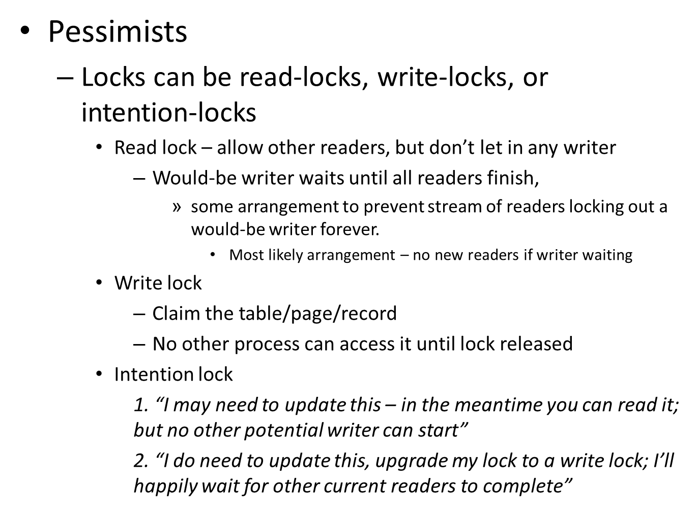
Optimists and Pessimists

Slide 54
Beware …
You can switch off “auto‐commit” and carefully delimit transactions with begin … commit bracketing
  And different transactions gleefully interfere and all your database consistency constraints are violated!
The default setting for all databases is “live fast, die young, leave a good looking corpse”
If you really want to control the behaviour of transactions you must consider the “isolation level” used.

Slide 55
Isolation levels
SQL standard defines a number of “isolation levels”
  Read uncommitted
    Useless – it means accept any random value you might see
  Read committed (the universal default)
    Read locks are released immediately, so data read by a transaction may get changed by another transaction while this first transaction still in progress
  Repeatable read
    Read and write locks held till end of transaction
  Serializable
    Read, write and range locks held for duration of transaction
      Range locks effectively block inserts and deletes

Slide 56
But it’s database dependent!
Interpretation of SQL standard isolation levels depends on the database;
databases don’t necessarily support all levels
(e.g. Oracle has only ‘read committed’ and ‘serializable’)
Further, while many databases support “intention locks” the use of such a lock must be specified in the SQL statement being executed –
Select * from table where id=? for update
  (And here there are differences – such a statement is valid in Oracle for isolation level ‘read committed’ but in DB2 it’s only valid for isolation level ‘repeatable read’)

Slide 57
Isolation levels
Higher isolation levels are performance killers
May have to trade off inconsistencies in database against speed of processing

Slide 58
… and the worst case
Transactions involving more than one persistent store (“message queues” as well as databases)!
Trying for atomicity (and even worse, isolation) when working with multiple databases is complex and can be very slow.
(So splitting your data into different sets on different machines may prove very detrimental – it just depends on how you use the data. If you may end up with atomic transactions accessing two database engines then the split of data was harmful not helpful.)

Slide 59
Distributed transaction
The way these work
  Invoke services of a transaction manager
  Contact the two databases telling them that they are to be part of a transaction managed by this separate entity
  Invoke SQL operations on the two databases
  Tell transaction manager to commit the transactions
    It must contact the different databases and ask if they can commit
      They can say no (the whole transaction will be rolled back); if they say yes they must make a copy of the data that will survive crashes and communications failures and lock tables so that nothing can happen to change their view that the transaction can be committed
    If all databases can commit, manager tells them to commit
  Lots of complex and slow message exchanges etc

Slide 60
A further caution
Databases lie.
  Examples
    It may have been fixed in modern MySQL with InnoDB tables, but the old MyISAM version supported all the APIs for transaction control – but totally ignored them in the implementation.
    SQLServer
      You can ask it to take part in a distributed transaction (using the special XA protocol that applies to these) – it will agree
      It takes not the slightest notice of all that stuff about needing to coordinate with other participants in the transaction
        XA support is disabled somewhere deep inside Windows (“potential security risk”) – you have to do some mighty contorted things to really enable XA and get SQLServer to participate properly in distributed transactions

Slide 61
Database
Optimizing your SQL

Slide 62
Ask for what you need,
It’s just too easy to simply say
select * from table where …
But often your application only requires a couple of attributes (columns) from a large record.
Much faster to have
select id, title from table where …

Slide 63
Be a little cautious with ORM
JPA is wonderful – EntityManager just gives you the object that you desire
But if you only want a couple of attributes?
  Same as last slide, asking for object is like select *
  Instead you can use constructor syntax:
  public class idtitle { int id; String title; …}
  …
  Query q = em.createQuery(“select new idtitle(td.id, td.title) from Data td where …”)

Slide 64
ORM
Make sure any collection members (or large members like a blob) are lazy loaded.
Problem:
  There is no way with an ORM system that you can specify extras like “for update” intention locks
    Very marked performance differences can be seen from proper use of these

Slide 65
Maybe “unnormalize” some tables
Possibly better to duplicate some columns in tables rather than perform too many joins

Slide 66
Database
You really don’t want or need a relational database!

Slide 67
Maybe you don’t want a relational database!
Relational databases are for storing complex data that are can be updated.
  Complexity comes from the relations that exist amongst tables
But often your data simply accrete, once added they are not changed – you really need a write once, read many data store.
  There are alternatives to relational databases.

Slide 68
Files!
Images are typically things that get created but are never changed – ideal for file storage.
But if you have very large numbers of large files then your standard OS file system probably won’t manage.
There are more specialised file server systems, e.g. MogileFS, that allow you to distribute the files over many cheap server boxes and their RAID disk arrays.
  Need to go through a program that works with the specialized file system and its API:
  remember, one of Apache configuration options allowed you to specify that all requests for files of type X (X=.jpg, .png, …) that cannot be handled via MMapFile cache should be directed to a specific handler process rather than treated as file requests

Slide 69
NoSQL data storage
Variety of storage technologies
  Google BigTable, Cassandra
    Row and column model (sparse matrix – many columns may be null any for specific record)
Split table across multiple servers
  Amazon SimpleDB, CouchDB
    Store “documents”, create multiple indexes
Little or no support for “relations” among records

Slide 70
NoSQL
Likely to be significantly better than a relational database for data that grow, may need to be searched subject to varying criteria, but not often updated
  Think of things like records from your logs
    Each is complete (no “related” data)
    None is ever updated
    Lots of searches needed to identify records that make up sessions, trace paths through a web site, etc

Slide 71
State data
It’s easier to scale up services if servers don’t have to maintain state

Slide 72
State
State data are necessary in many applications
  Personalisation data
    E.g.
      Amazon’s “the products you have viewed today”
      Facebook settings etc
  The “shopping cart”
  …

Slide 73
Storing state data
Shuffle data back and forth between client and server
  Client effectively storing state and restoring it in server when needed
Hold data in client
  Now more practical with LocalStorage and AJAX – could use this for much of “personalization” data
Hold data in server
  Keyed by session key for client

Slide 74
Shuffling data
Cookies
  20 cookies per site
  4Kb per cookie
  Returned with subsequent requests
    Use a “path” specification so only returned when requesting server to execute code, not returned with other requests such as “GET mystyle.css”

Slide 75
Troubles with cookies
Firstly, they are transferred back and forth with every request/response
  Cookie transfer (80Kb ?) will slow all requests and responses in which they are exchanged
Secondly
  Exposed data
    hijacked,
    molested,
    …

Slide 76
You say “Encrypt the cookies”
What key?
  The server has to decrypt the cookie to get back state data.
    Don’t rely on “security by obscurity”, hacker will probably guess the encryption algorithm that you have used, only needs the key
  Shouldn’t always use the same key
    Lots of decrypt attacks become possible if one key is used for lots of traffic
      Hacker could get some cookies set with a very good idea of content (“Iput book with ISBN 0‐123‐432678 into my cart and got this stateful cookie; I put CD with id … and got this; …”)
      Hacker runs the brute‐force attacks and gets the key
    If you use the same key for everyone, hacker has won.
  So an individual key
    Who remembers the key? It’s state data!!

Slide 77
Key in cookie
Possible strategy
  Use a cookie to hold the value representing the encryption key
  Key itself is something for a fast encrypt/decrypt scheme e.g. DES (or something a little fancier – “DES++”)
  All other cookies have values that are DES++ encrypted using this key
  But the value sent for the key cookie is itself encrypted (using expensive slow public/private key encryption)
    You pick your DES++ key for this particular client
    You encrypt it using your public key and send to client
    You use it when encoding the values for other cookies
    Back come the cookies in a subsequent request
    You decrypt value of key cookie with your private key getting back the DES++ key (which you had forgotten in the meantime)
    You can now decrypt the other cookies

Slide 78
State in client
LocalStorage
  This technology is ready to be exploited
    Well suited to the real “personal computer” –
      the portable tablets, micro‐laptops, smart phones etc
  Less limitations than cookies, more storage than cookies!
  Most obvious use – personalization data
  Javascript with your pages checks local storage
    Can then do things
      Like initialize (some) fields of forms displayed subsequently
      Send AJAX requests for up to date information on topics previously of interest to client – information that can be formatted and displayed in side‐bars

Slide 79
State in server
Java:
  Session object in memory, keyed by session id
PHP
  File in local file‐space, identified by session id
.Net
  Your choice
    In memory
    In file
    In a kind of Windows local version of Memcached

Slide 80
State data in “memcached” server
Possibly better to avoid technologies that involve state being held on a specific server machine
  $_SESSION[] or servletcontext.getSession()
Instead, use the session id as the key for storing data in a memcached cluster
  Data will be stored on one of memcached servers
  All web‐app engines will have access to the machines in this cluster
  So don’t have to bind requests to a particular web‐app server machine

Slide 81
Monitors

Slide 82
It’s too slow!
It’s too slow.
The usual response
  Guess what’s wrong, dive in to coding a fix.
  You’ve probably tried this on program code and wasted lots of your time optimizing some code that wasn’t even on the critical path.
Eventually you learnt
  Before optimizing code, get execution profiles that show where the program spent its time.
Same applies to web‐apps
  Measure first, only when you know what the slow steps are should you think of optimization.

Slide 83
Monitoring page requests
Use your logs
  Should be able to get some idea of time to response
An initial slow request, followed by many other identical requests that get cached data –
  It probably doesn’t matter that the first access was slow
Consistently slow responses
  Add monitors to the code
    This is where those servlet extensions like filters and listeners might be useful – you don’t change any code, you simply add the monitor and reference it in the web.xml deployment data.
  Monitors to try to identify specifically what operations are slow

Slide 84
Monitoring performance of components
Secondary use of monitors
  Time those page transactions that are likely to be of more interest to paying users
    Initially, find the typical time that the transaction takes
      Write timing data to log file or data base table; when have accrued sufficient data gather some statistics on typical time and variation
    Subsequently
      Write timing data to log files; on weekly basis run an analysis of logs – are the timings changing from those for past month (for better or for worse), if significantly for worse – try to find why
      Build in an alert system
        If a time measurement is significantly greater then normal, log it separately
        Have background process checking whether getting an unacceptable number of long transactions being logged – if there are send an action alert request to sys admins

